Slide 2
Personal Expense Tracker
By Nikhil Agarwal and Muskan Agnihotri

Slide 3

Project Overview
Personal Expense Tracker
A simple tool to help users record and analyze their daily expenses.
Stores data in a MySQL database and leverages pandas and NumPy for data analysis.
Includes features for adding, viewing, updating, deleting, and visualizing expenses.

Slide 4

Technology Stack
Programming Language:
Python
Database:
MySQL
Libraries:
mysql-connector-python
pandas
matplotlib
NumPy
PrettyTable
Datetime

Slide 5
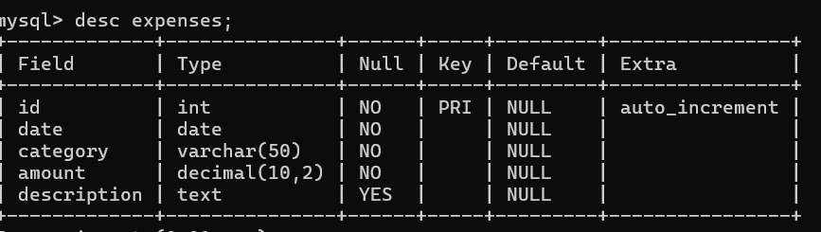
Table Structure

Slide 6
Key Functions
Add an Expense
View Expenses
Generate Summary Report
Update an Expense
Delete an Expense
View Expenses by Category
View Expenses by Date Range
Calculate Average Monthly Expense
Analyze Expenses
Visualize Expenses

Slide 7
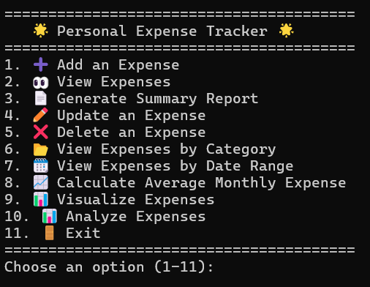

User Interface

Slide 8
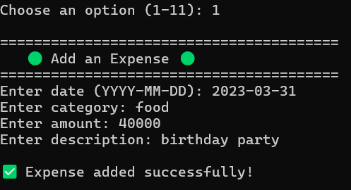
Adding an Expense

Slide 9
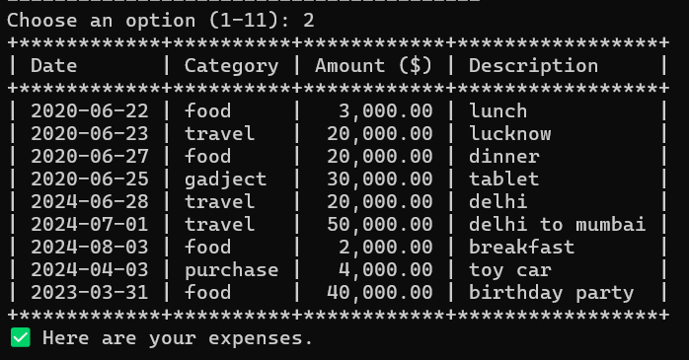
Viewing Expenses

Slide 10
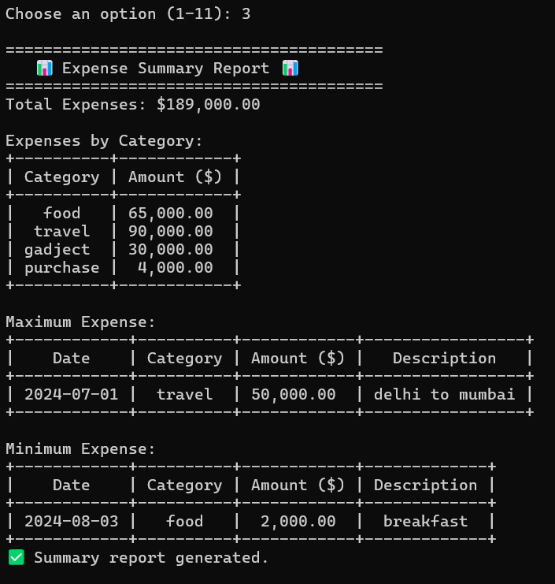
Generating Summary Report

Slide 11
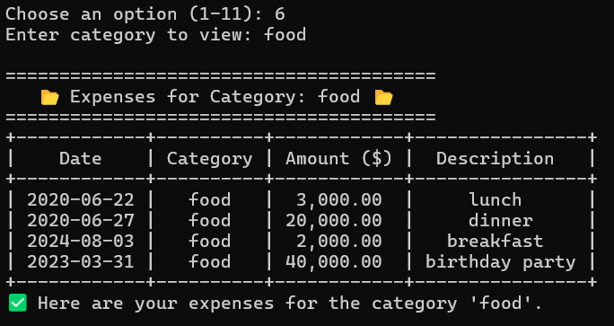
Viewing Expenses by Category

Slide 12
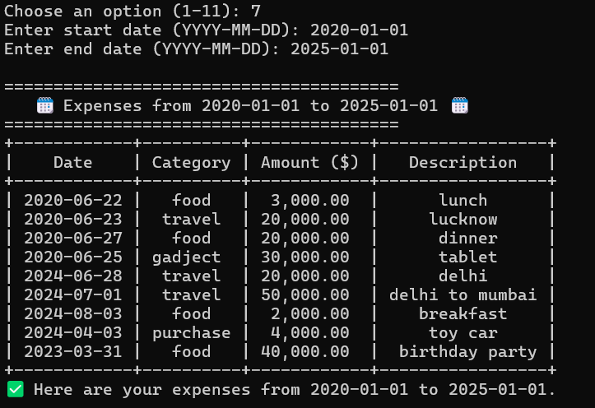
Viewing Expenses by Date Range

Slide 13
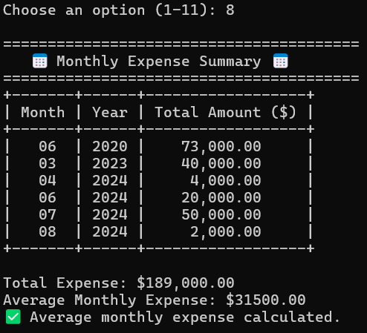
Monthly Expense Calculation

Slide 14
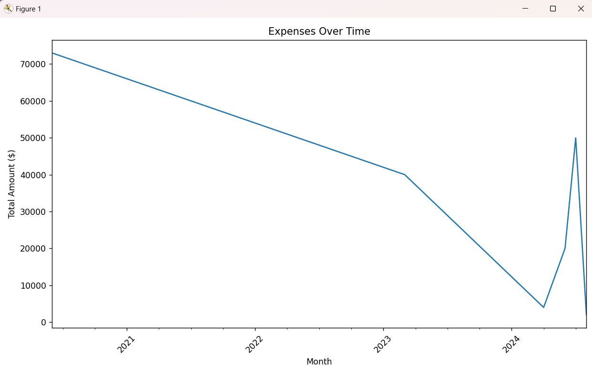
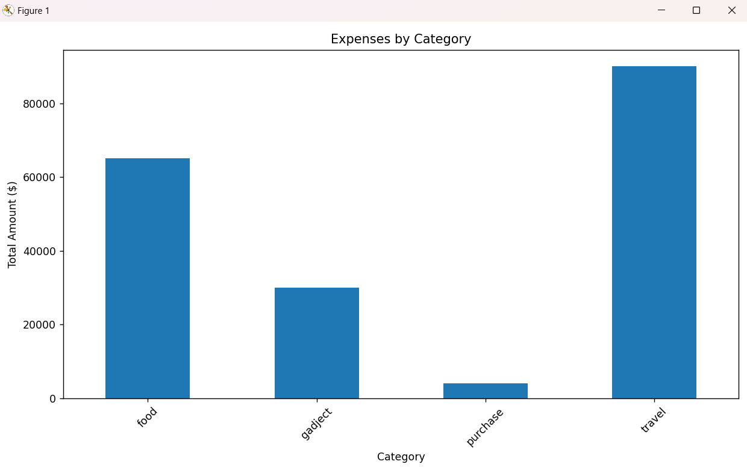
Visualizing Expenses

Slide 15
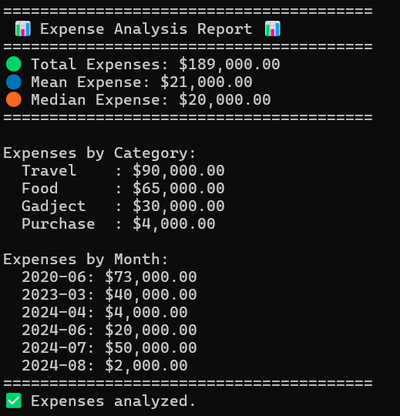
Analyze Expenses

Slide 16

Time to say Good Bye

Slide 17
Conclusion
Project Summary
The Personal Expense Tracker is a comprehensive tool for managing personal finances.
Utilizes MySQL for data storage and pandas/NumPy for data analysis.
Provides functionalities for adding, updating, deleting, analyzing, and visualizing expenses.

Slide 18

Our Learning

Slide 19

Thank You

